Slide 1
Customer Executive Analytics
Marketing View
Product Usage
Customer Analysis
Ragaavi D
💁🏽‍♀️. Mail | LinkedIn | Tableau | Medium

Slide 2
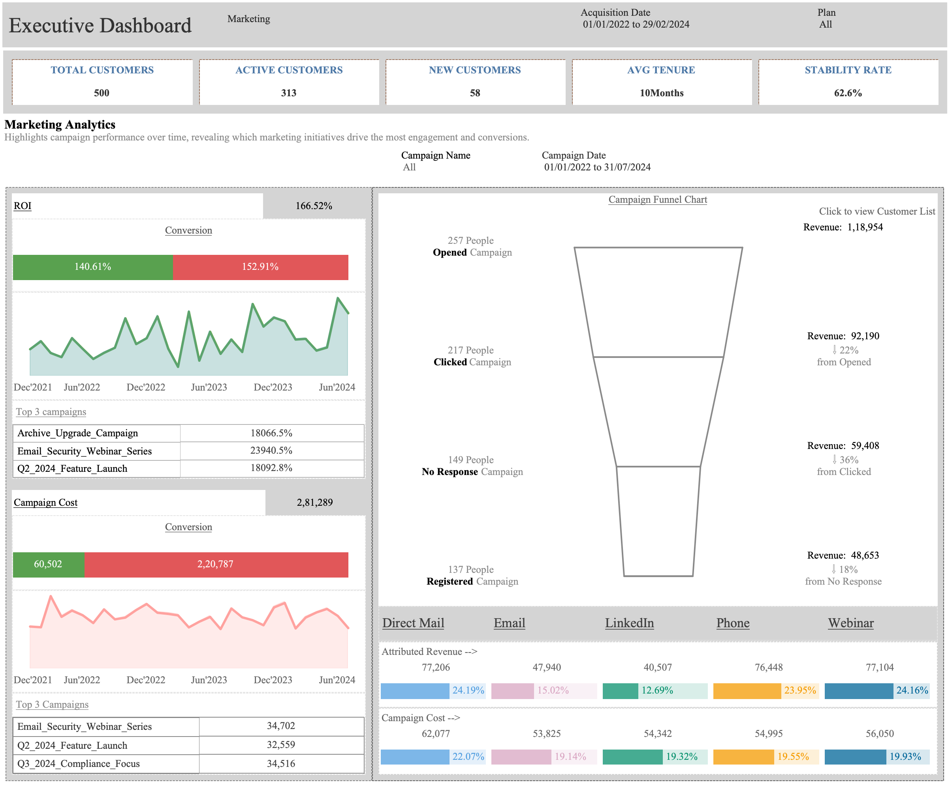
1
3
2
4

Slide 3
MARKET ANALYTICS
FILTERS: Acquisition Date(Start Date) , Plan
KPI Cards
  Total Customers: Count of Customers
  Active Customers: Status = Active Customers
  New Customers: Customers subscribed in current Quarter of Latest Acquisition Date
  Average Tenure: Average Months for a customer to subscribe a plan and be in our system
  Stability Rate: Overall Retention Rate
Comparison Charts
  ROI: ROI percentage, ROI for Market Campaign Converted or Not split, ROI across period, Top 3 Campaigns
  Campaign Cost: CC, CC for Converted or Not split, CC across period, Top 3 Campaigns
Campaign Funnel Chart
  Sales Activities from Opened till Registered, Revenue generated at each stage
Channel Distribution
  Revenue and CC from different Channels

Slide 4
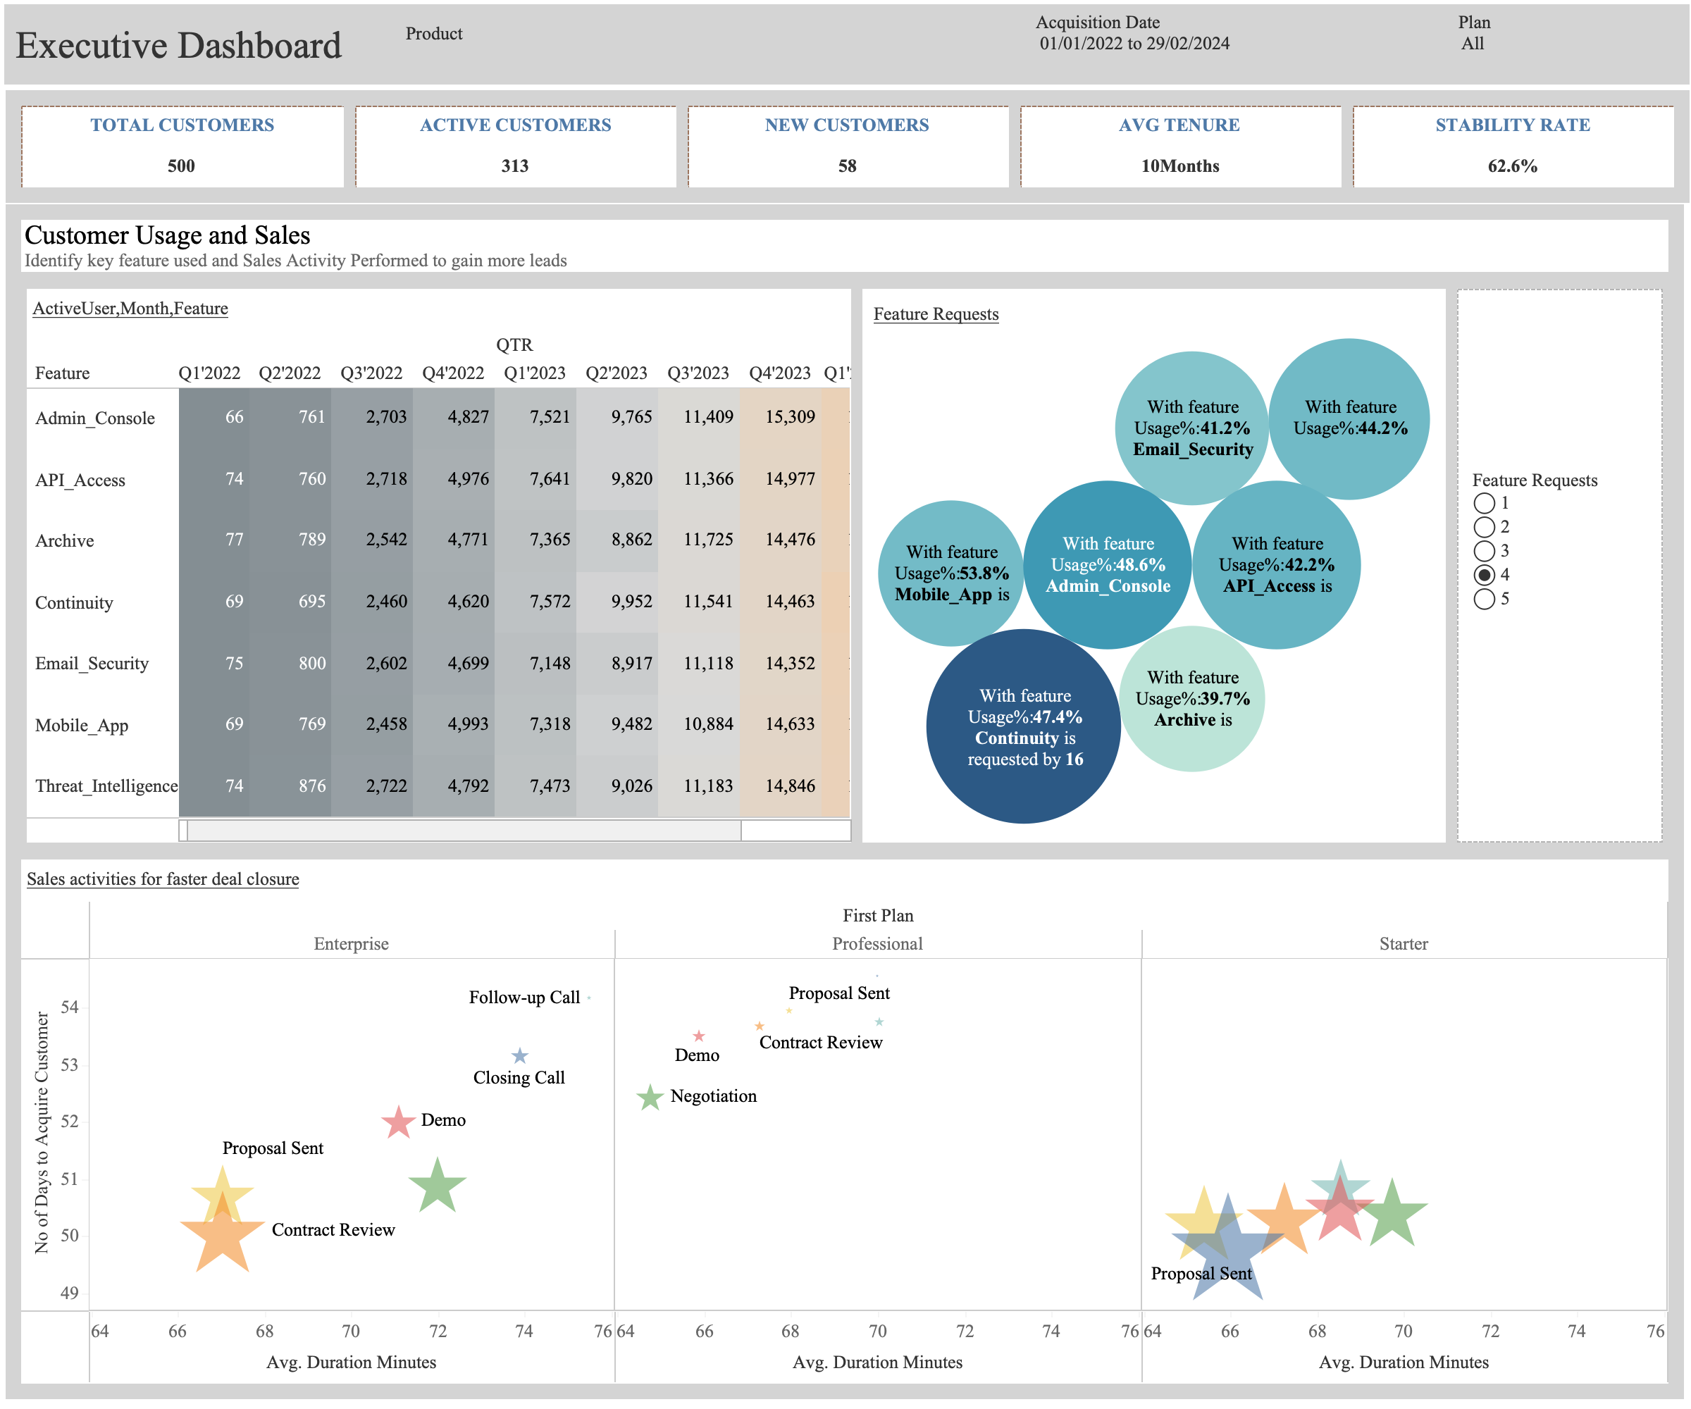
1
2
3
4

Slide 5
USAGE ANALYTICS
FILTERS: Acquisition Date(Start Date) , Plan
KPI Cards
  Total Customers: Count of Customers
  Active Customers: Status = Active Customers
  New Customers: Customers subscribed in current Quarter of Latest Acquisition Date
  Average Tenure: Average Months for a customer to subscribe a plan and be in our system
  Stability Rate: Overall Retention Rate
Feature and Active Usage:
  Quarterly distribution on active customers across each feature
Feature Request
  Based on Usage Frequency for each feature we can decide which request the product team team developing
Sales Activity
  Answers which Sales activity results in faster deal closure

Slide 6
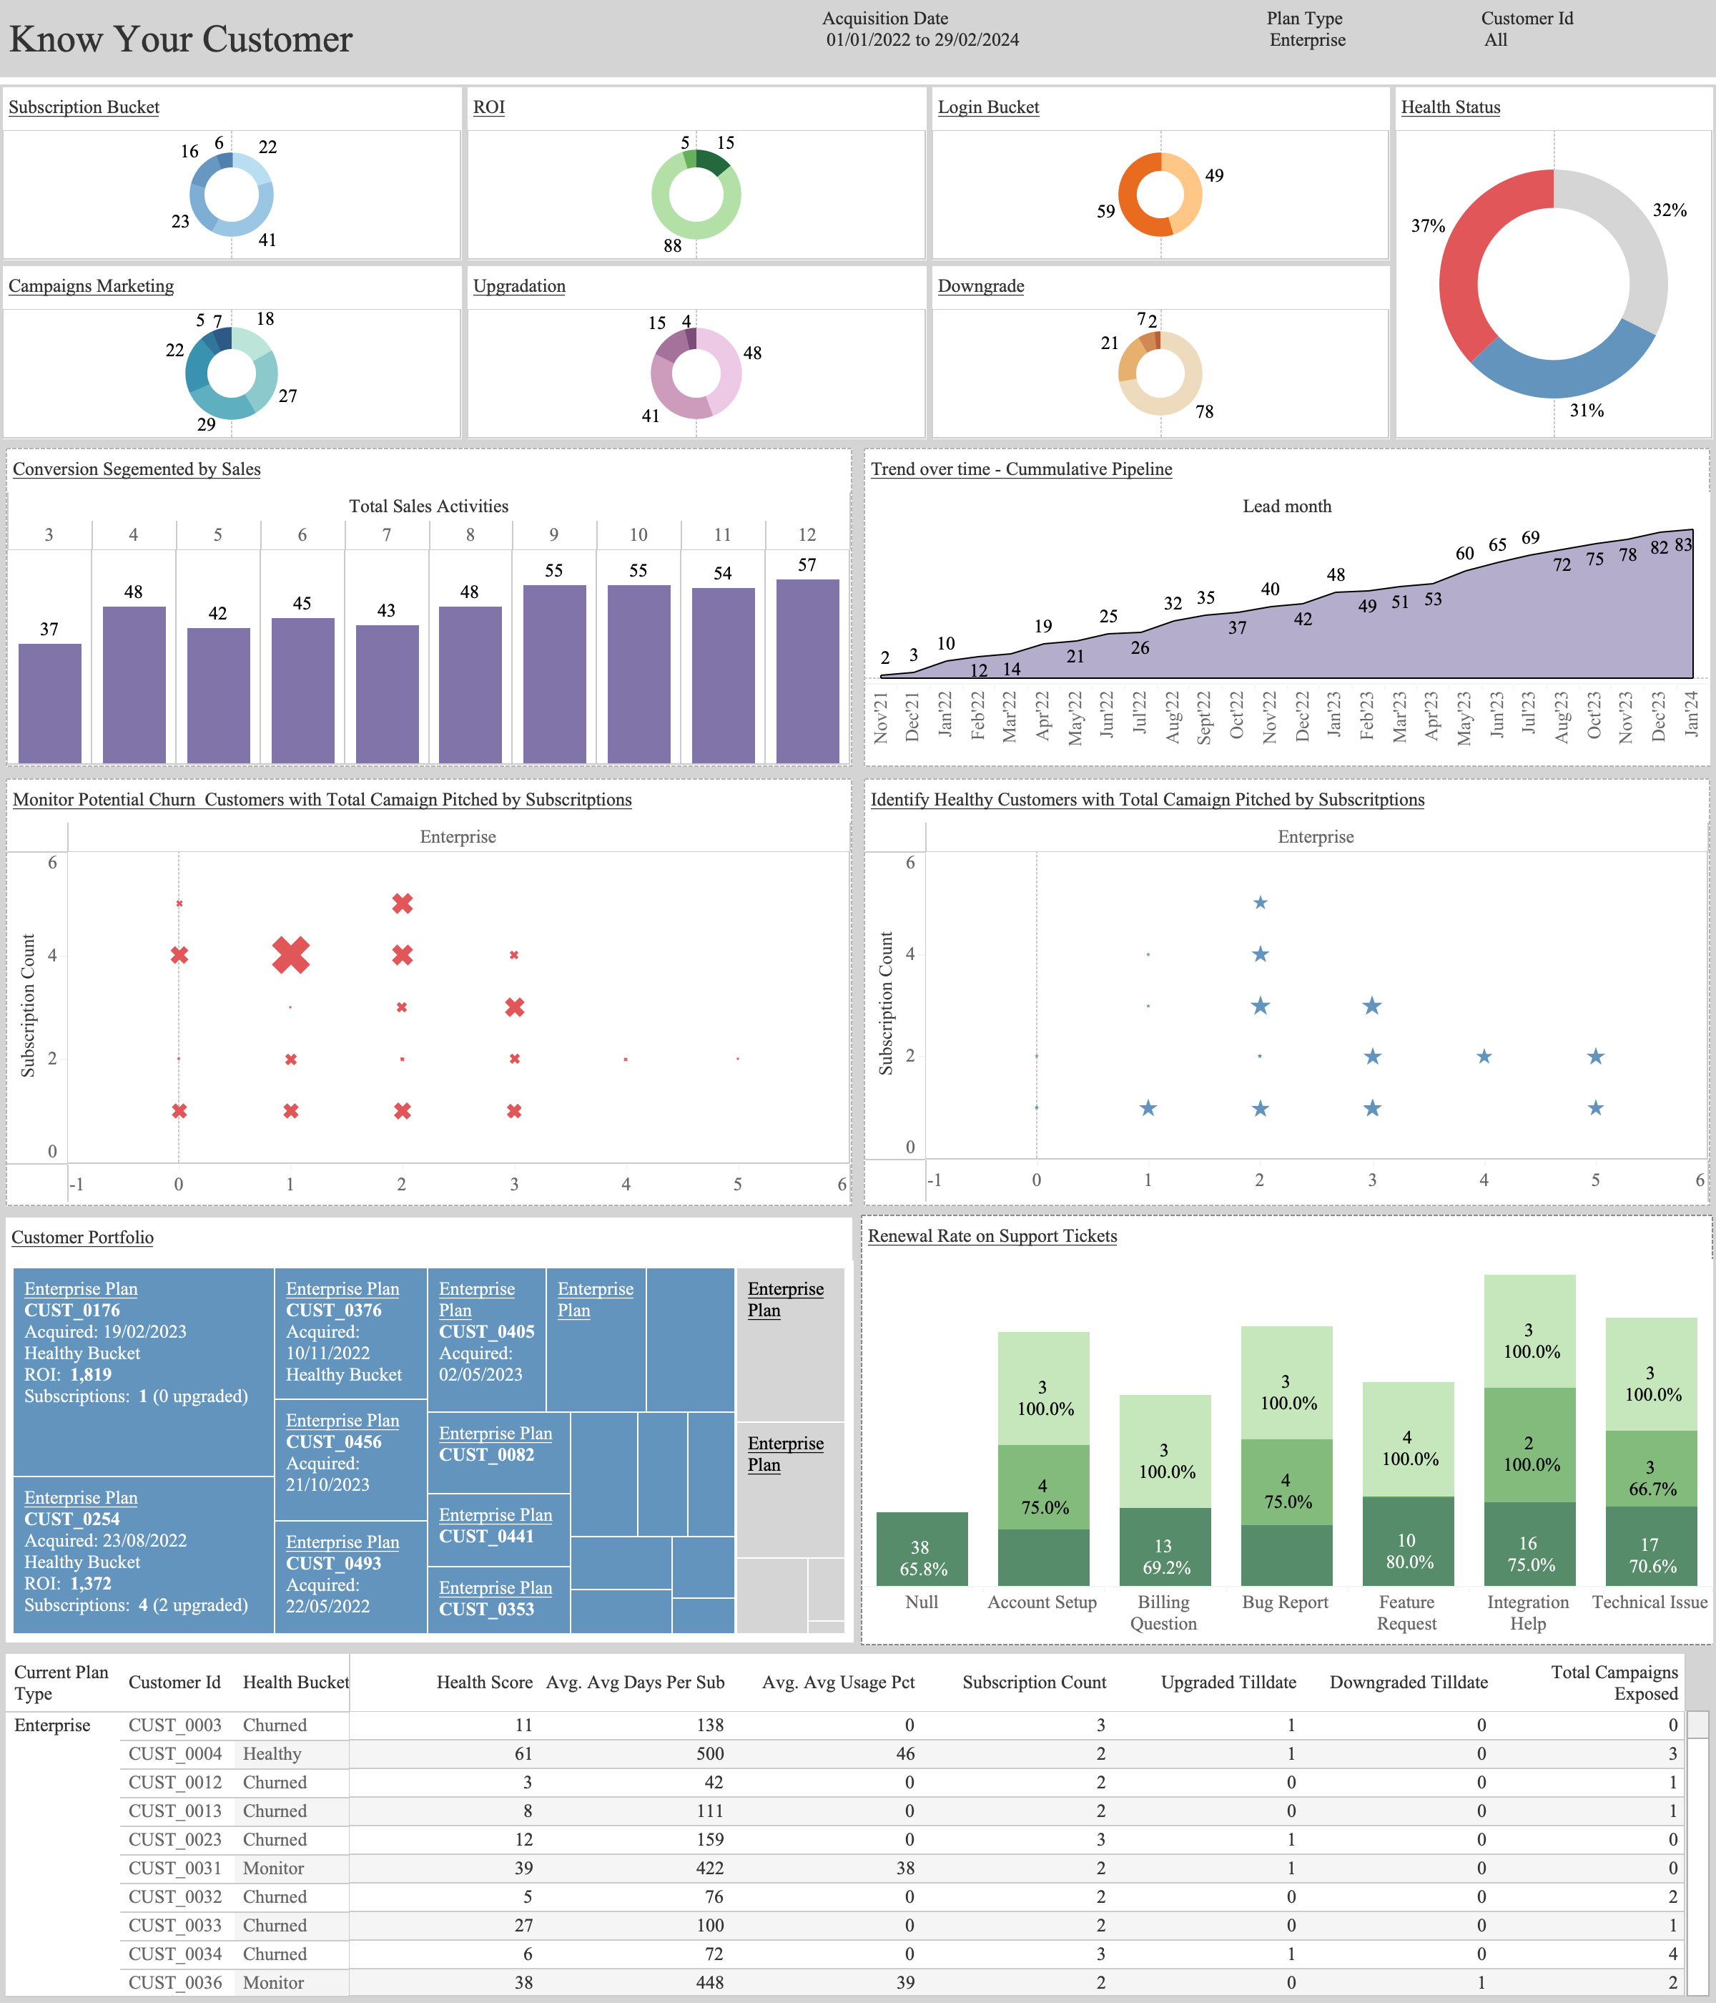
1
2
3
4
5
7
6
1

Slide 7
CUSTOMER ANALYTICS
FILTERS: Acquisition Date(Start Date) , Plan, Customer id
Donut Charts
  Based on Plan selected distribution of customers are showing on following KPIs: Subscription Bucket; ROI Bucket; Login Freq; Campaign exposed; upgrade; downgrade; Health Score
Conversion Segment by Sales:
    Sales Activities bin for Customer distribution
Trend Over Time - Cumulative Acquisitions:
    In the Lead Month how many customers acquired
Monitor Customer Churn
    Correlation between Campaign exposed and Subscription made. Even Though Subscription count is higher, customer churns if there is less marketing campaign activity
Healthy Customer Activity
    Correlation between Campaign exposed and Subscription made. More campaigns Exposed, more subscription made.
Customer Portfolio
    From Acquired Date, How many subscription made, if upgraded, ROI and Health score are listed
Renewal rate on support tickets
    Ticket Bins for Renewal Rate across Customers
Base Table

